Slide 1
Colorado Storm Data: 2015-2016 How do you plan the Storm budget?
By Adam Lang
A Presentation for the Colorado State Budget Office
Notes:
Welcome everyone from the Colorado State Budget office. This presentation is based upon the 2015-2016 NOAA national weather service storm data for your beautiful state of Colorado. Our Data Science department spent a great deal of time data mining this information and analyzing trends and important pieces of information that will help you better plan your state budget for storm/weather management for the coming years.

Slide 2
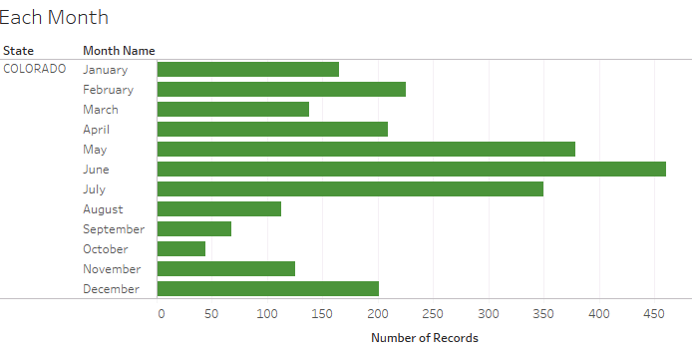
A Year of Storm Activity: Where should you focus your budget?
Notes:
June, May and July are the 3 months with the most storm/weather activity in the state of Colorado.
We will call this the first tier of extreme weather events which is mostly in the spring/summer.
The ‘second tier’ of most weather events occurs on the winter months January, February, December.
I would think you want to focus your budget for the fiscal year on these two sets of months, however, I will tell you there are “extreme’ events that occur in months with less weather events you should also plan to focus on and we will get to these later in the presentation.

Slide 3
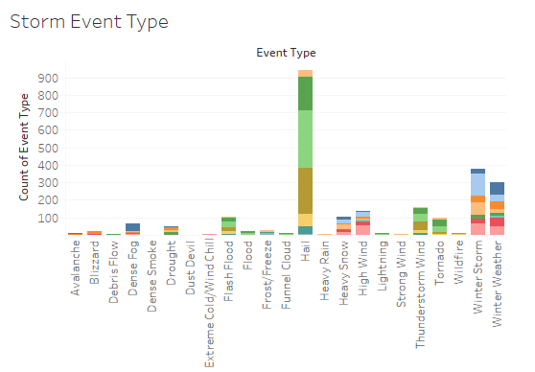
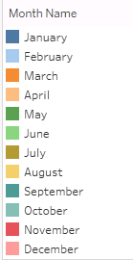
A Year of Storm Activity
Notes:
There are many layers of granularity to this data set
The previous slides showed us the months with the most weather in two tiers
This data visualization shows us the Storm events that occur the most. The months are color coded. We will dissect the most important months in the following slides.
Let us focus for a second on Hail. Notice it has 6 layers of colors meaning it occurs in 6 months out of the year and the amount of hail events we see is by far mountains above the rest.
Lets direct our attention now to Winter storms. There are 7 layers of winter storms meaning 7 months out of the year snow is falling somewhere within Colorado. This is important information to plan for storm crew removal of the snow.
Tornados, floods and Thunderstorm wind are the next set of events that occur 4 months out of the year.
As you can see there are other “minor” weather events as there are many different climates in Colorado but not all are of concern for your budget. We will touh upon the most important aspects in the coming slides.

Slide 4
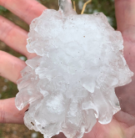
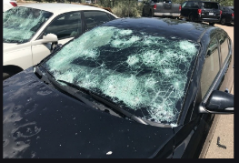
Most Common Storms: Spring/Summer
May, June, July
Hail
Thunderstorms
Tornados
Flash Floods
Most Storm Damages!
Notes:
May/June/July are the busiest months for storms in Colorado. These weather events above are what we most often see in the spring and summer months.
Hail → Thunderstorms → Tornados → Flash Floods are the most common events in that order
These weather events are responsible for the most storm damage throughout the year. We will discuss this in further detail in coming slides.

Slide 5
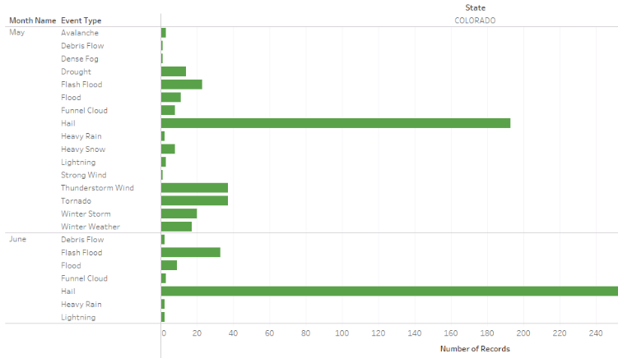
May and June: Hail prevails as the most common storm type. Thunderstorms, Tornados and Flash Floods are also common.
Notes:
Stacked bar graphs of May and June. Examples of the most common weather.
May is the most varied month of the year as there is winter weather as well as the aforementioned hail, flash floods, tornados and thunderstorms. There are even Avalanches, dense fog, debris flow, winter storms and winter weather.
May should be a primary beginning focus of your state budget as it has the most variable weather we see in this data set.

Slide 6
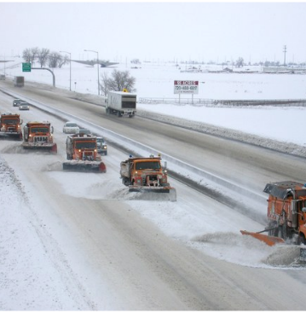
Most Common Storms: Winter
December - March
Winter Storm
Winter Weather
Heavy Snow
High Wind
Dense Fog
February MOST winter weather: CDOT storm crews are needed most!
Notes:
December, January and February are the winter months with the worst weather, the 2nd tier of weather events as I mentioned earlier
February is the month with the most winter storms. For your winter and February budget this may be the top event you plan for: more storm crews available to clear the roads. This includes Colorado Department of Transportation (CDOT) storm crews for high elevation mountain pass roads and avalanche mitigation management on dangerous highways and roadways.

Slide 7
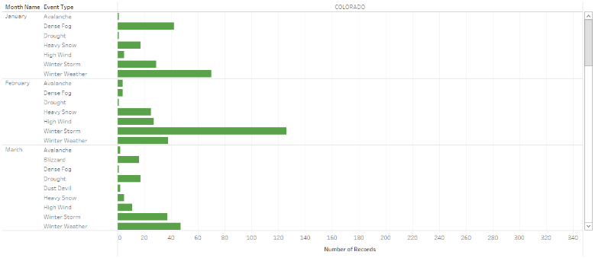
Winter Weather prevails December – March
February has the most winter weather of all the months: prepare your storm crew budget!
Notes:
Pictured above we focus on January – March. December is identical to these months even though it is not included.

Slide 8
Least Common Storms: Still a concern
Debris flow
Dense fog
Wildfires
Lightning
Droughts
Avalanches
These events occur January-April and September –November
As a whole they are not as destructive but are worth planning for
Notes:
These are less common weather events but are important to still plan for in your budget

Slide 9
Storm Damages
Damaged Crops
Flood
Flash Floods
Tornados
Spring – Summer Months
Damaged Property
Flood
Flash Floods
Hail
Tornados
Thunderstorm Wind
Notes:
Flooding is very common in Colorado and should be a primary planning point in your state budget. It depends mostly upon the winter snow melting. As much as you plan for winter storms and snow plowing you should plan for flooding to follow.
Flooding is the primary cause of the most damaged property and damaged crops in the state of Colorado. We will see just how destructive on the following slide via a data visualization.

Slide 10
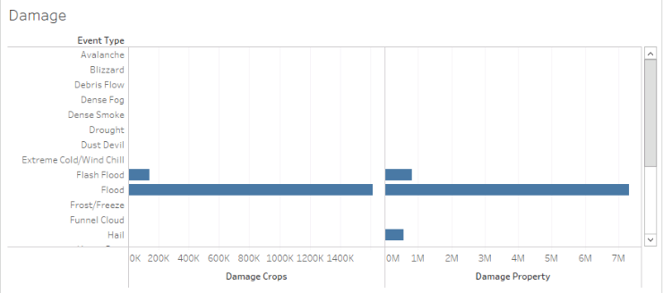
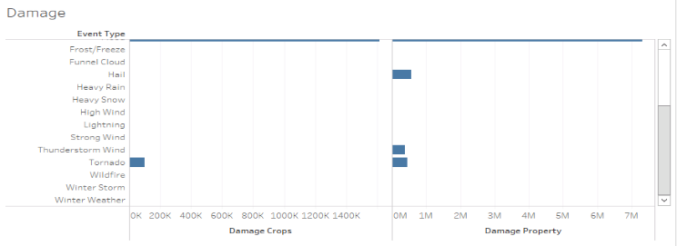
Notes:
Stacked bar graph representation of damaged crop and damaged property weather events. They appear almost identical except for damaged property including hail and thunderstorms wind.
As you can see: Flooding takes up almost 7million reported damaged property occurrences and 1600k damaged crop events.
Of note, Tornados, Hail and Thunderstorm Wind while less than 1million for damaged property and less than 200k for damaged crops are still relevant. Especially if you remember the most common spring/summer event in Colorado are hail storms!

Slide 11
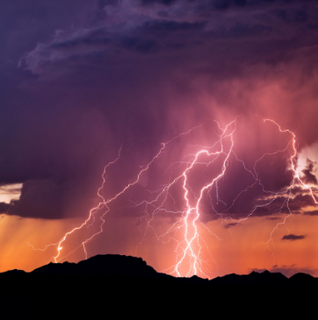
Injuries from Weather
Injuries
Lightning: over 20 people struck a year
Thunderstorms
Tornados
Avalanches
Notes:
Lightning is the primary source of injury from weather events with over 20 people struck a year. This also is a concern for infrastructure. Colorado’s high altitude makes it more susceptible.
From 1980 to 2018 Lightning has killed 98 people and injured 477. It kills around 3.5 people a year on average and injures around 17 per year. This is consistent with our data findings (McKee, 2019).
Most lightning strikes occur between 1pm and 3pm in the spring/summer months and usually hits people who are hiking or enjoying the outdoors.
This is important in your state budget consideration as a matter of safety as Colorado is a top state for outdoor tourism. Consider contributing to advertising and promoting lightning safety.

Slide 12
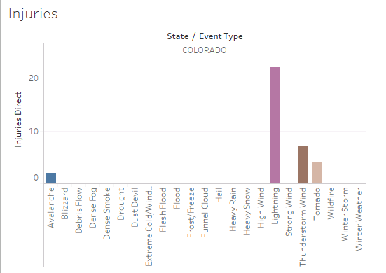
Notes:
The raw data showing our previous slides information. As you can see the most common weather events (hail, flooding, tornados, snow/winter events) don’t contribute to as many injuries as lightning, thunderstorm win, tornados and avalanches.
The data showed there were 22 injuries reported for Lightning strikes which is more than the yearly average of 17.

Slide 13
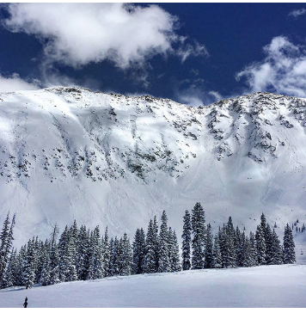
Storm Deaths
Avalanche: 4
Lightning: 3
Thunderstorm Wind: 1
Notes:
Avalanches just like Lightning are one of the most dangerous storm events in Colorado.
Avalanche mitigation should be part of your storm budget every year. Avalanches effect highways, local roads, airports, towns and cities not just ski areas.
On March 8, 2019 roughly 346 Avalanches had been reported over 7 days (Berwyn, 2019). There may not be as many deaths but the risk increases every year with global warming.
Global warming can affect avalanches: More moisture in warmer atmosphere means more snow and larger avalanches; Warmer temps make snow layers collapse and slide; more rain on snow events.
Avalanches affect the economy: transportation corridors interrupted which affects food and energy supplies and even access to Colorado’s $5 billion a year ski industry (Berwyn, 2019). You should plan for the affects of Avalanches not just in management but the risk it carries every year to Colorado’s infrastructure.

Slide 14
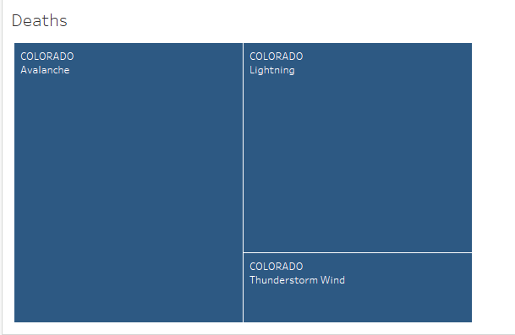
Notes:
A Tree map visualization of the hierarchy of storm deaths from weather events in Colorado
Avalanche → Lightning → Thunderstorm Wind
As we can see Avalanches and Lightning are of primary concern for danger in the high altitude of Colorado.

Slide 15
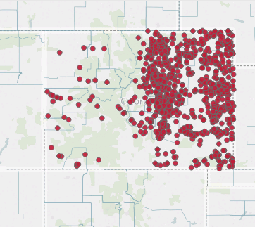
Colorado Map: Where are the Weather Events?
Notes:
Most reported weather events are east of the Continental Divide of the Rocky Mountains where most of Colorado’s population lives (Colorado Demographics, 2019). The cities of Denver and Colorado Springs are the main population centers and their suburbs make up most of the population of the state.
What is not pictured are the high ways and road systems of the state but knowing the weather events are reported around the population centers we could easily compare this map to a transportation related map in the future.

Slide 16
Questions?
Contact information
1-720-WEA-DATA
Email: coloradoweatherdata@colorado.gov

Slide 17
References
Berwyn, B. (2019) Avalanches Menace Colorado as Climate Change Raises the Risk. Retrieved from: www.insideclimatenews.org.
Colorado Demographics (2019) Colorado Cities By Population. Retrieved from: www.colorado-demographics.com
McKee, S. (2019) The Numbers Behind Lightning Strikes and Casualties in Colorado. Retrieved from: www.outtherecolorado.com
NOAA 2015-2016 Storm Events. Retrieved from: https://ncdc.noaa.gov/stormevents/

